Slide 1

Lesson 8
Lesson Intention:
Accurately describe the Aboriginal workers’ situation, from the perspective of a worker on a Pilbara cattle station and illustrate how this situation changed because of the Pilbara Strike.
Success Criteria:
I can explain the causes and effects of the Pilbara Strike and how it changed the experience of Aboriginal people in WA​
I base my conclusion about the Pilbara Strike on the research and resources we have explored in this unit​
I can create an accurate before / after depiction to show my learning
The 1946 Strike / Y6 / HASS / Lesson 8 / 1

Slide 2
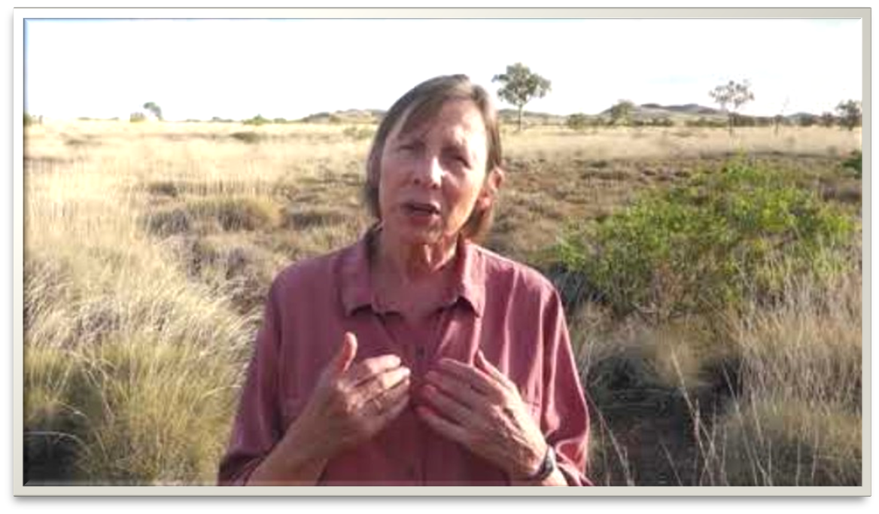
Recap
What terms used in this
video to describe the
Aboriginal labour force?​
What do you think ​
“we gotta run our own show” means? ​
What did the workers decide
they needed to do?
Roy Rosenzweig Centre for History and New Media [video]:​
The Pilbara Aboriginal Strike https://youtu.be/1CM5SyPsdRE?si=VQ1489Rk8FPhKXpc​
The 1946 Strike / Y6 / HASS / Lesson 8 / 2

Slide 3

The goals that the strikers sent to the Department of Native Affairs were clear:
Raise the minimum wage to 30 shillings per week​
Grant Aboriginal people the right to elect representatives​
Grant Aboriginal people the right to
freedom of movement within Australia.
Source: https://commonslibrary.org/australian-aboriginal-workers-strike-for-fair-wages-and-equality-1946-1949/
The 1946 Strike / Y6 / HASS / Lesson 8 / 3

Slide 4
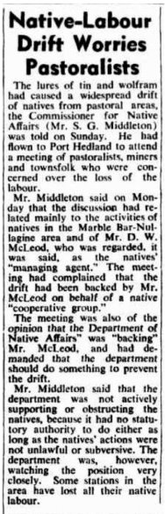
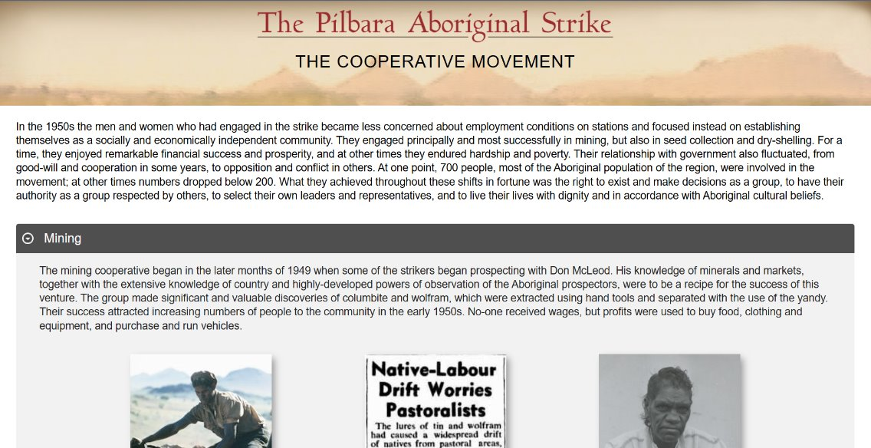
Cooperative Movement
“Some stations in the area have lost all of their native labour.”
Why would Aboriginal workers be moving from pastoral areas?​
Why are the pastoralists worried about losing labour?​
What do you think they wanted the Department of Native Affairs to do?
http: pilbarastrike.org
West Australian (Perth, WA : 1879 - 1954), ​
Wednesday 22 August 1951, page 2​
from National Library Archive​
http://nla.gov.au/nla.news-article48986703
The 1946 Strike / Y6 / HASS / Lesson 8 / 4

Slide 5
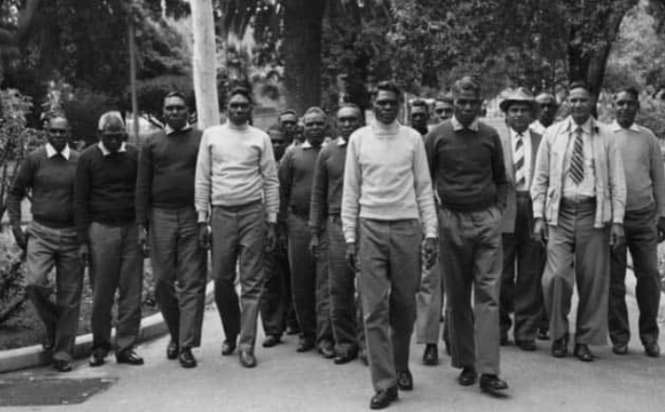
The effects of The Pilbara Strike
What they achieved: ​
the right to exist and make decisions as a group, ​
to have their authority as a group respected by others, ​
to select their own leaders and representatives ​
to live their lives with dignity and in accordance with Aboriginal cultural beliefs
Original source unknown
https://solidarity.net.au/aboriginal/the-pilbara-strike-how-aboriginal-workers-defied-forced-labour-and-exploitation/
The 1946 Strike / Y6 / HASS / Lesson 8 / 5

Slide 6
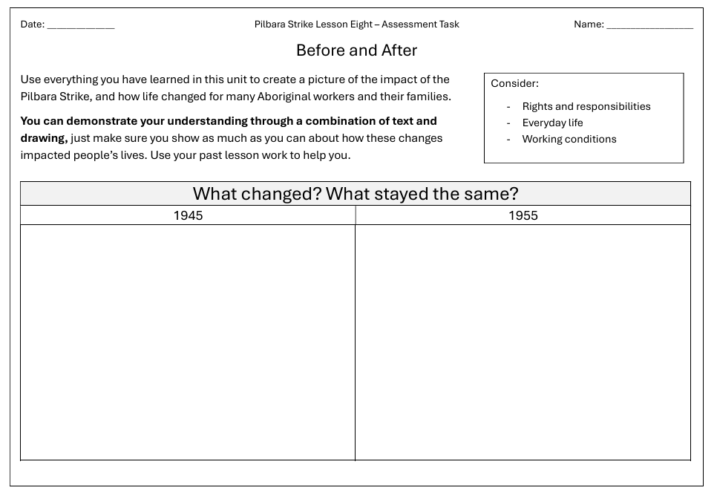
Lesson 8 - Assessment Task
The 1946 Strike / Y6 / HASS / Lesson 8 / 6

