Slide 1


Lesson 6
Lesson Intentions:
Demanding the right of pay for work done: learn how civic action can be taken to change unfair working situations by looking at how the Strikers organised themselves and the actions they took.
Success Criteria:
I can locate and collect information about the main people and events of the Pilbara Strike from a range of sources
I can record the information I collect using a variety of methods (note-taking, tables, matching cards)
I can identify some of the challenges the strikers faced and how they overcame these.
The 1946 Strike / Y6 / HASS / Lesson 6 / 1

Slide 2
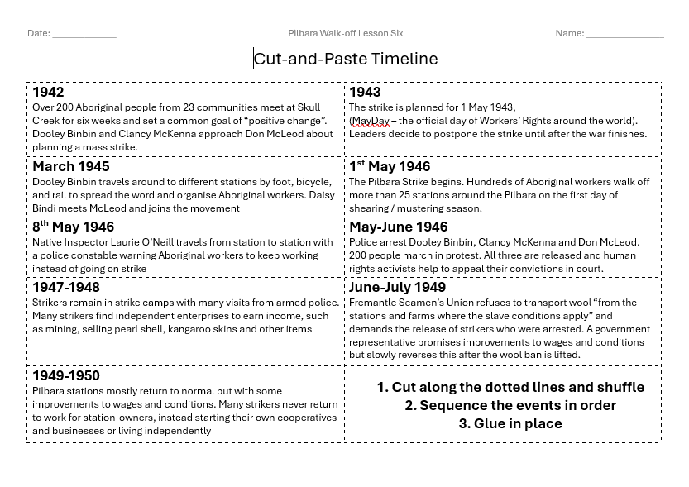
Timeline
Cut out along the dotted line
Shuffle up the events
Sequence in chronological order
Glue into your workbook
The 1946 Strike / Y6 / HASS / Lesson 6 / 2

Slide 3
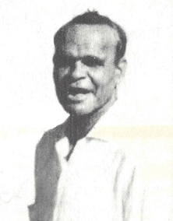
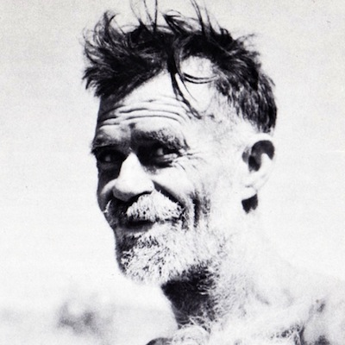

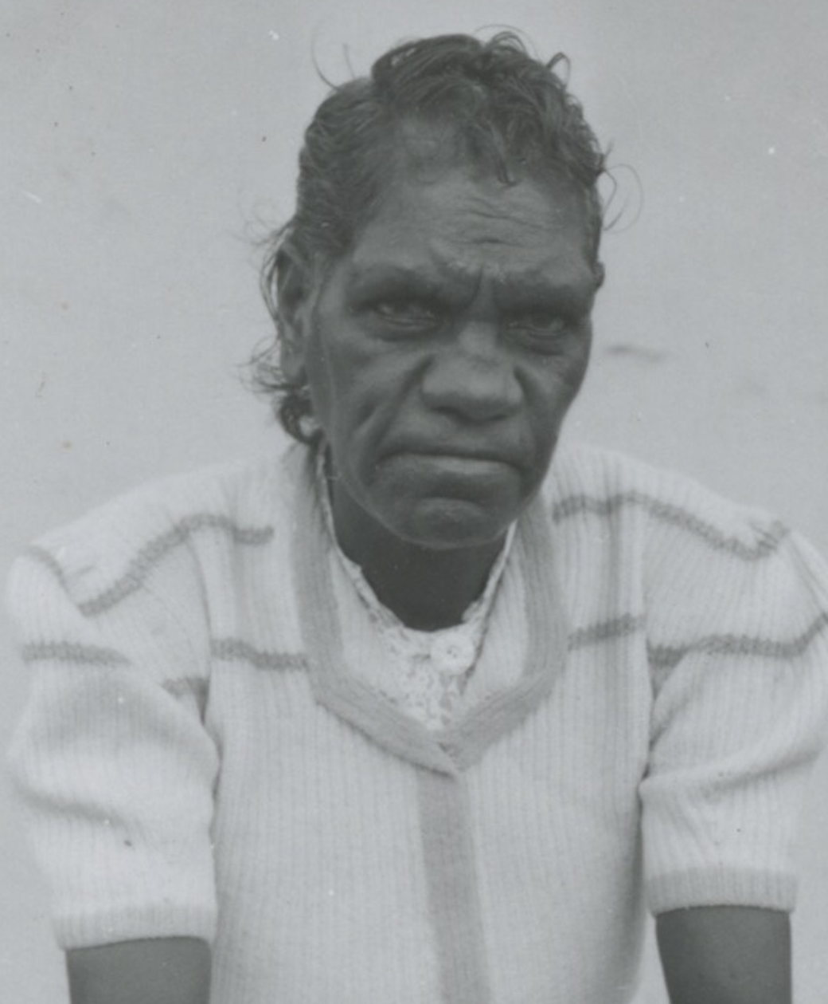
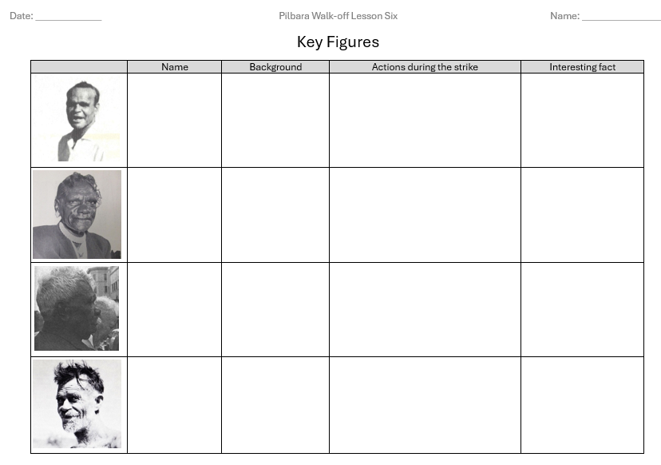
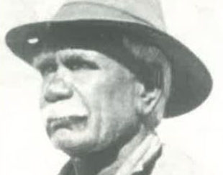
Key Figures
Scan the QR code
Find info on these four key figures and use this to fill your worksheet
The 1946 Strike / Y6 / HASS / Lesson 6 / 3

Slide 4
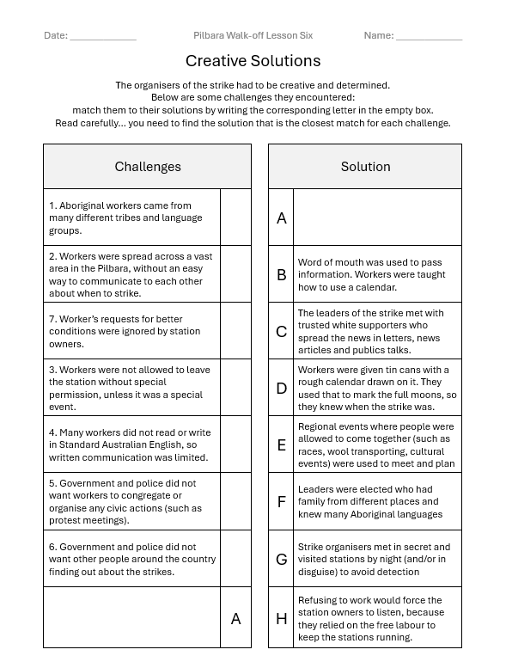
Creative Solutions
Read the list of challenges the Pilbara Strikers faced
Match each challenge to the solution the Strikers found.
Add your own Challenge and Solution you may have learned about the Strikers
The 1946 Strike / Y6 / HASS / Lesson 6 / 4

