Slide 1

Lesson 5
Lesson Intention:
Compare the two girls in the story (character study)
Choose one of the girls and write what happens next in the story from their perspective.
Success Criteria:
I can connect my knowledge of the Pilbara stations with information in the text to compare two story characters
I can write a paragraph from the perspective of one of the characters
I can use powerful verbs to create a clear picture for the reader
The 1946 Strike / Y6 / ENGLISH / Lesson 5 / 1
Notes:
Note that we will be using what we have learned about the Aboriginal workers on the Pilbara stations in our English lesson today.
Lets quickly recap what we know…

Slide 2

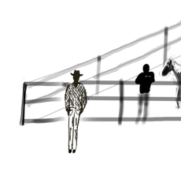
One station, two girls – Rose Murray
It was a bright wintry morning at Bangalow Station in the Pilbara. The breeze danced across the red plain and along the sandy riverbed, shaking the old paperbark leaves.
The girl Lily emerged from her maya, made from old corrugated iron and branches. She grabbed a big empty tin and began the too-long walk, up the bank to the homestead’s garden tap. She shivered. Her thin dress and bare feet didn’t help with the cold. The water sloshed in the tin as she hurried back to the little fire her Dad had made for billy tea.
As she passed their sleepy hunting dog, he lazily wagged his tail, just once. Lily smiled and thought how different he looked when flying through the scrub chasing down a marlu. That picture reminded her they needed fresh meat today. Scraps from the station kitchen would not do.
Lily knew the few rations for the old people in the camp were nearly gone. The whole family would be happy with full bellies, if the hunt was successful. It was getting harder to hunt as the many cattle, camels and goats wrecked waterholes and ate the bush tucker her family had always eaten. For all the work her parents did in the house and the stockyards, they only got a little food and a few clothes… bush tucker was needed. On the station next door some Marrngu stockmen did get paid a couple of bob. Lily remembered her Dad saying, “It’s never the same as the white man’s pay.”
The 1946 Strike / Y6 / ENGLISH / Lesson 5 / 2

Slide 3
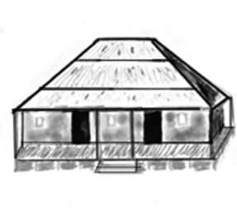
Today was a big day for the family, as the boss had said Lily's brother had to come to the stockyards to help the men. Just a little older than Lily, Tom was about 13 years old and looked nervous as he sipped his tea from a jam tin. Soon Dad and son grabbed their hats and made their way up the riverbank. Lily hoped her brother would be safe with the horses and wild cattle.
Lily’s Mum had been at the homestead since dawn cooking on the wood-fired stove, preparing breakfast for the manager, his family and a young white stockman fresh from the city. With the war going on, many workers had gone overseas.
Lily walked up to the large homestead and quietly watched her Mum through the door as she stirred the big pot of porridge. With no warning the missus came into the kitchen and said, “Nell, the Policeman from Marble Bar is coming today so he could be here for lunch. So best make some extra bread today.”
Spotting Lily she said,
“Go get that broom and sweep the verandah.”
Lily walked up to the large homestead and quietly watched her Mum through the door as she stirred the big pot of porridge. With no warning the missus came into the kitchen and said,
“Nell, the Policeman from Marble Bar is coming today so he could be here for lunch. So best make some extra bread today.”
The 1946 Strike / Y6 / ENGLISH / Lesson 5 / 3

Slide 4
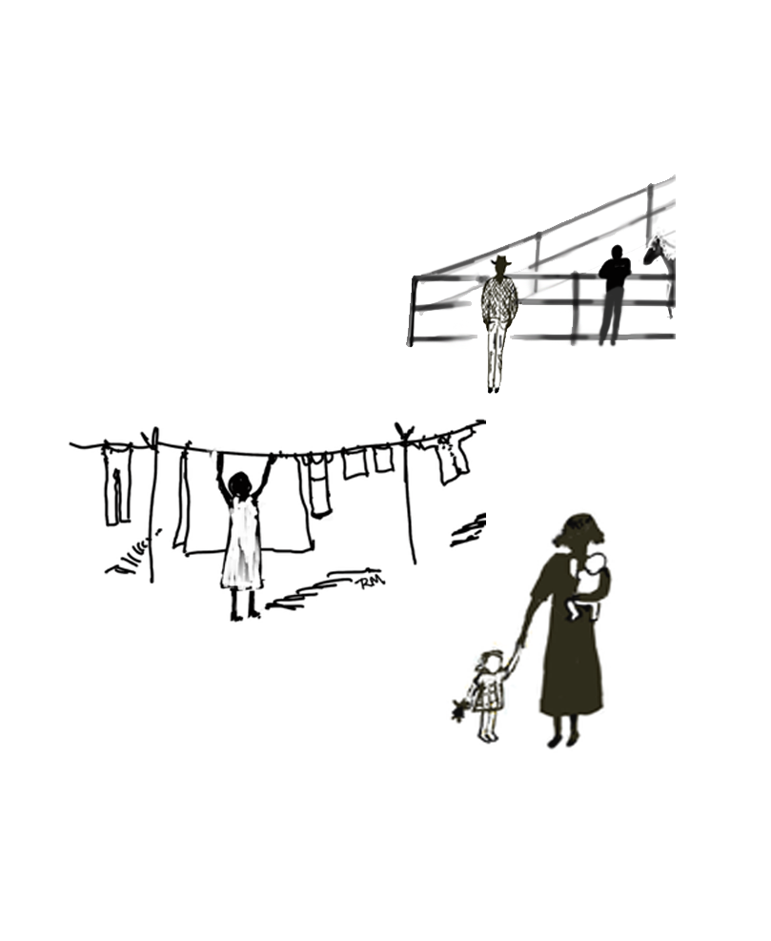
Spotting Lily she said,
“Go get that broom and sweep the verandah.”
When she left the kitchen, Nell went outside to Lily and whispered in her own language,
”Quickly finish. Go hunting with Kaparli and Karluji until the Policeman’s car leaves.”
Lily knew that her young relations had been stolen from their families and sent to Mission schools far, far away. Would they come back as good Christian maids, like they’d heard? Would they ever come back? The Policeman was the Protector, the boss of all kids like Lily.
The fly-wire kitchen door banged as Nell disappeared.
Deep in thought, Lily jumped and dropped the broom.
Just then, Sally the boss’s daughter came belting around the verandah corner. The two girls were the same age, and Nell had looked after Sally since she was born.
The 1946 Strike / Y6 / ENGLISH / Lesson 5 / 4

Slide 5
Sally tripped over the broom and landed on the dusty verandah. Lily looked down at the fresh dirt on Sally’s pretty dress and the scuff marks on her shoes. Lily got a fright and helped Sally up. Sally dusted herself off and started laughing but stopped when she saw that Lily’s eyes had welled up with tears.
“Don’t worry Lily, it’s not my best dress. Nell will wash it.” Sally confidently said. Just then they both heard the sound of boots walking on the verandah. Lily’s head was spinning. She leapt over the broom and ran flat out, over the soft green lawn and down towards the dry riverbed, kicking up dust as she went.
Sally ran after her but stopped and yelled out,
“Lily come back and play! I’m going back to boarding school on Friday.”
Sally dropped her head. She was sad knowing that things would be different when she next came back home to Bangalow. Her mother would have a new baby. Lily would be looking after him or her and Sally would be expected to learn all the things the wife of a station owner should know. No time for play.
The 1946 Strike / Y6 / ENGLISH / Lesson 5 / 5

Slide 6
Vocabulary
Powerful verbs
emerged
shivered
sloshed
came belting
dusted
Nyangumarta language
Marlu = kangaroo
Marrngu = Aboriginal person
Maya = shelter, hut
Kaparli = grandmother on Dad’s side
Karluji = grandfather on Dad’s side
The 1946 Strike / Y6 / ENGLISH / Lesson 5 / 6

Slide 7
Character study
 | Lily | Sally
Who is she?
Appearance (clothes, hair)
Family
What is on her mind in this story?
Complete the chart on your worksheet to compare the characters of Lily and Sally.
How do Lily and Sally’s lives differ?
What are their perspectives on the events happening around them?
The 1946 Strike / Y6 / ENGLISH / Lesson 5 / 7
Notes:
Note that we will be using what we have learned about the Aboriginal workers on the Pilbara stations in our English lesson today.
Lets quickly recap what we know…

Slide 8
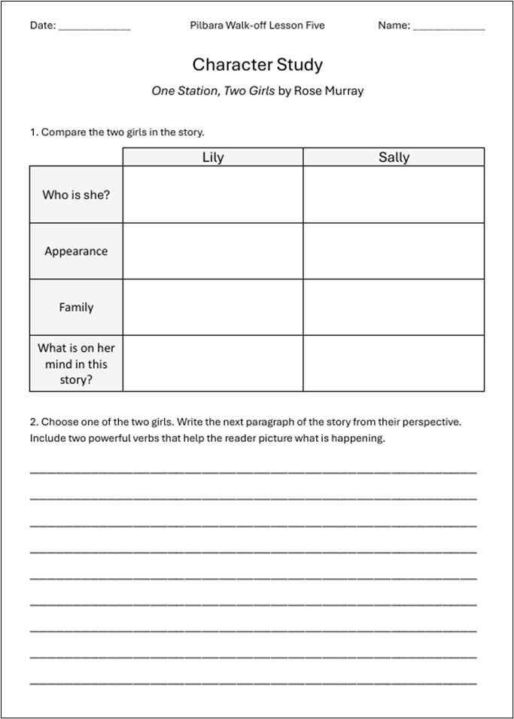
Independent Writing
Write a paragraph to describe what happens next for Lily or Sally (pick one).
How do you think she feels as she navigates the next part of her day?
Write a paragraph to describe what happens next for Lily or Sally (pick one).
How do you think she feels as she navigates
the next part of her day?
The 1946 Strike / Y6 / ENGLISH / Lesson 5 / 8

