Slide 1

Lesson 4
Lesson Intention:
Identify types of work carried out by Aboriginal people and how they were paid.
Case study: the Pilbara wool and cattle industry
Success Criteria:
I can describe the working conditions of Aboriginal people in the Pilbara wool and cattle industry in the 1940s
I can collect information from primary and secondary sources such as photos, videos and maps
I can brainstorm different actions that could have been taken to improve the workers’ situation, and what the impact might have been
The 1946 Strike / Y6 / HASS / Lesson 4 / 1

Slide 2
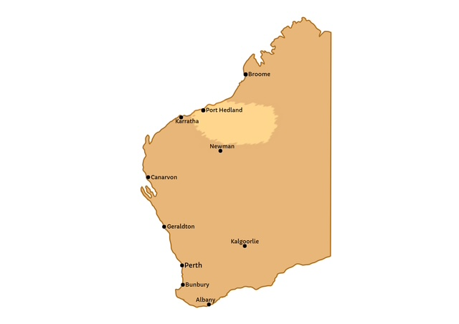
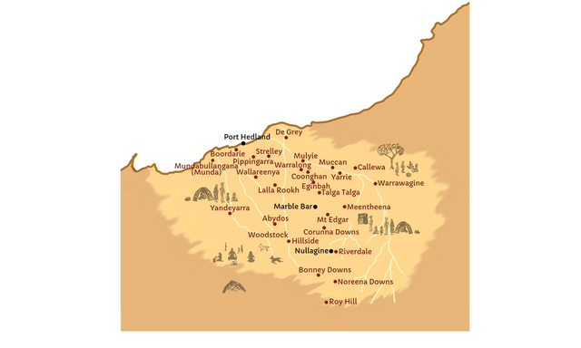

The Pilbara region is in the North-West of Western Australia
The 1946 Strike / Y6 / HASS / Lesson 4 / 2
Notes:
Ask students to locate:
Strelley on the map.

Slide 3
Let’s review some photos of work in the Pilbara
Who is working in each photo?
What are they doing?
What do the working conditions appear to be?
What comment do you want to make about the work
  Does the work look hard?
  Would you expect to be paid a full wage for this work?
  Who does this work benefit?
The 1946 Strike / Y6 / HASS / Lesson 4 / 3

Slide 4
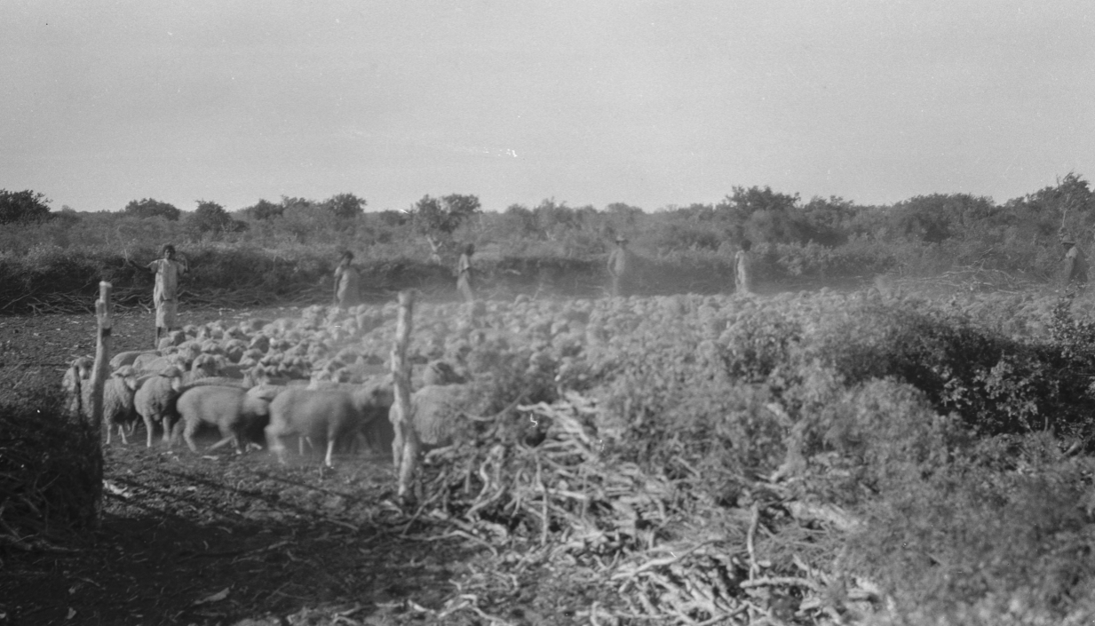
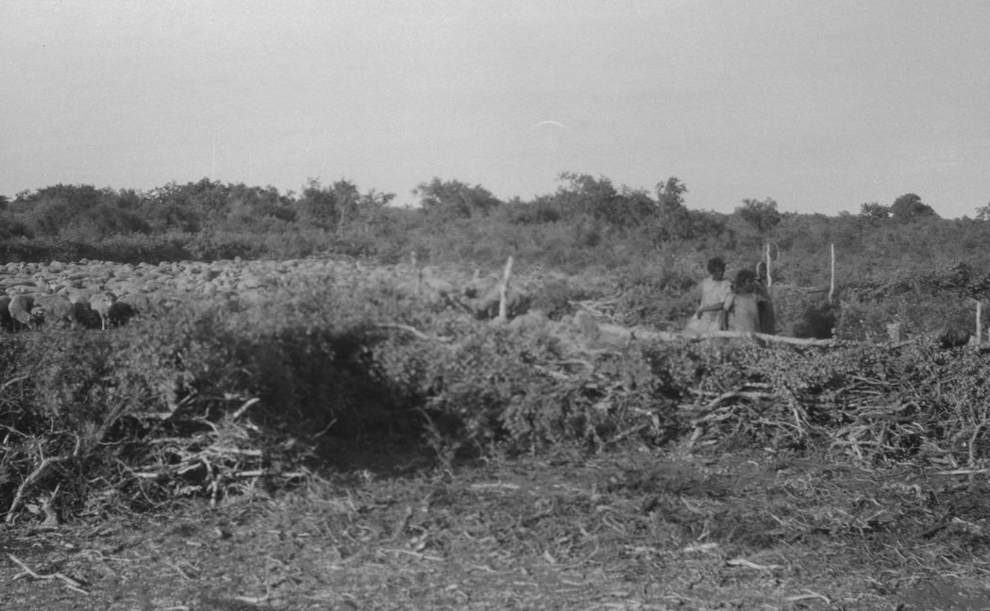
Sheep muster at Wallal in 1935
State Library of WA 112586PD
State Library of WA 112587PD
The 1946 Strike / Y6 / HASS / Lesson 4 / 4

Slide 5
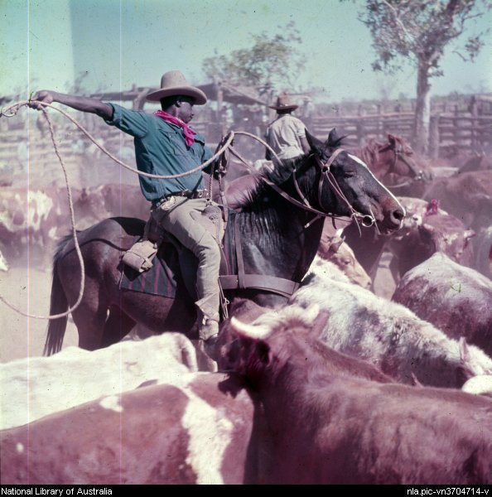
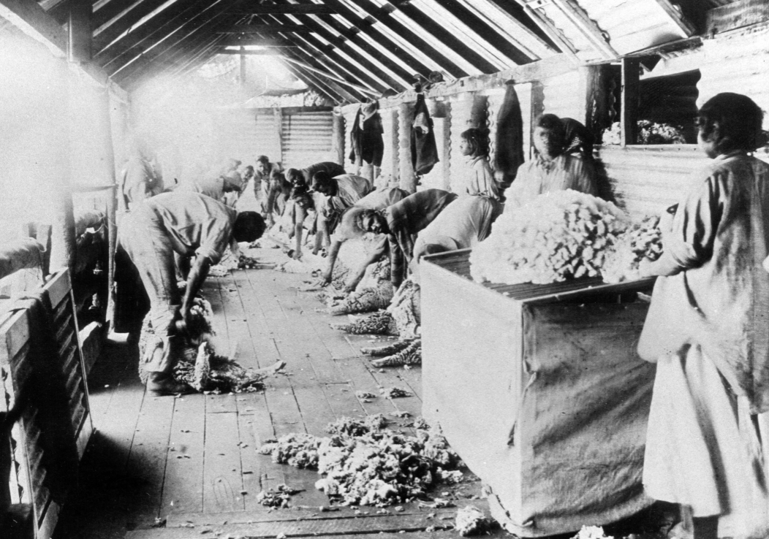
Working with livestock
http://nla.gov.au/cat=vn8811676 Victoria River Downs
State Library of WA 001304D Corunna Downs
The 1946 Strike / Y6 / HASS / Lesson 4 / 5

Slide 6
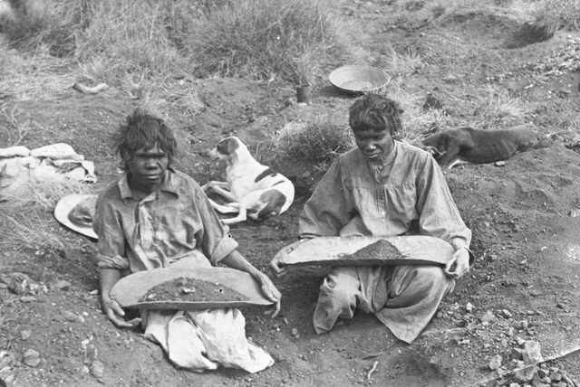
Working with minerals at Moolyella
https://storylines.slwa.wa.gov.au/archive-store/view/6/10467
The 1946 Strike / Y6 / HASS / Lesson 4 / 6

Slide 7
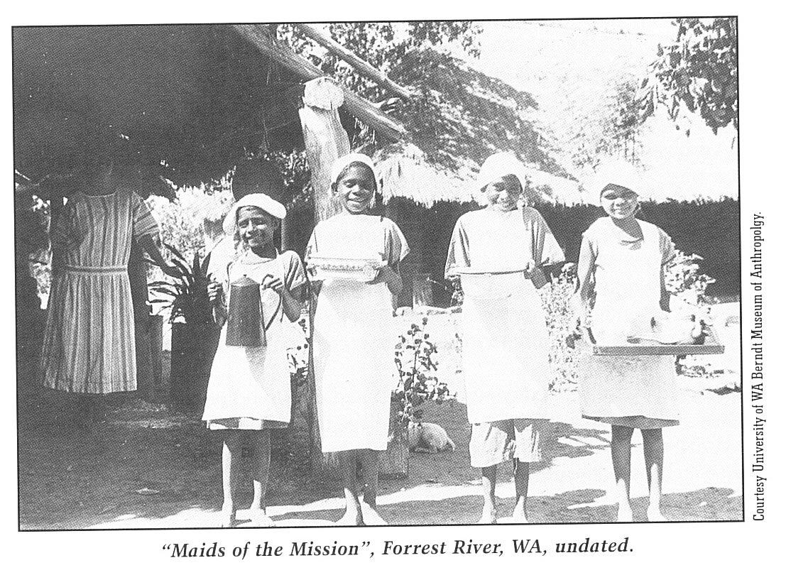
Learning to work in station homesteads
The 1946 Strike / Y6 / HASS / Lesson 4 / 7

Slide 8
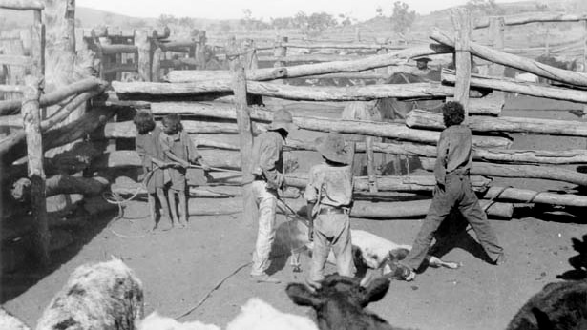
Learning to work with livestock at Moola Bulla
https://nla.gov.au/nla.cat-vn8811676
The 1946 Strike / Y6 / HASS / Lesson 4 / 8

Slide 9

Watch “Red Dirt Riders: 3 Year Strike”
Is this video a primary or
secondary source?
What is its purpose?
Discussion:
What were Aboriginal workers in the sheep and cattle industry paid?
Do you think this was fair?
The 1946 Strike / Y6 / HASS / Lesson 4 / 9
Notes:
0:30 Weren’t paid with money – were paid with sugar, flour, tobacco
Was it enough for them to live well?
How did this income compare to how people were living prior to colonisation and being forced into the European labour force?

Slide 10
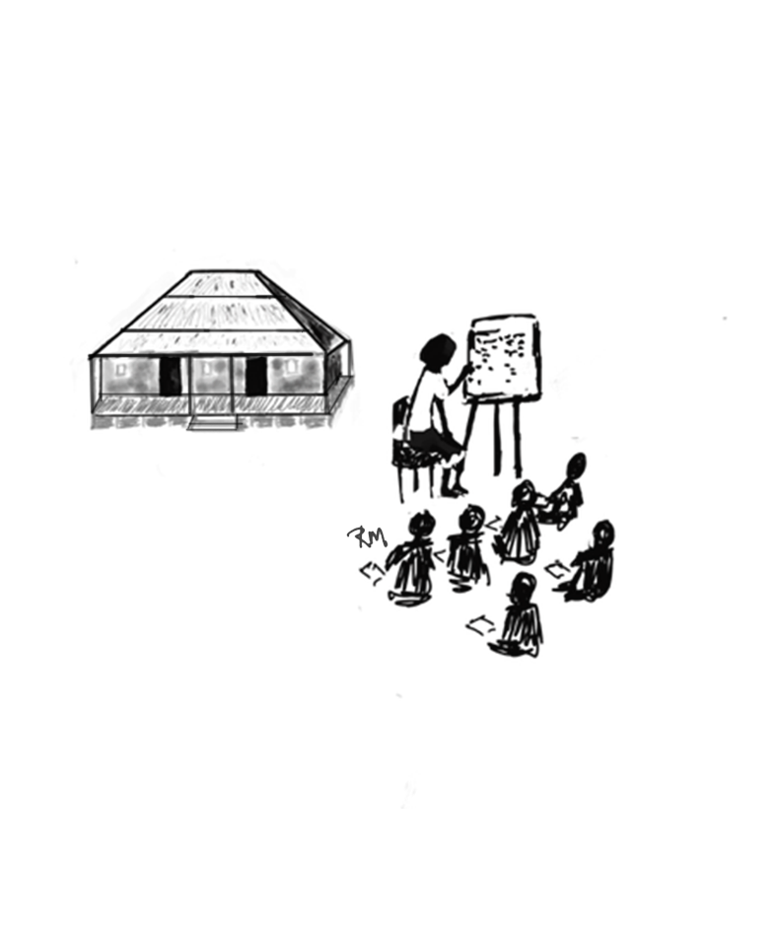
Group Activity - Brainstorm
What actions could Aboriginal workers have taken to change their situation?
What actions could other Australians have taken to change this situation?
What are the possible benefits / risks of these actions?
What are the possible benefits / risks of these actions?
The 1946 Strike / Y6 / HASS / Lesson 4 / 10
Notes:
Examples:
Write a letter
Talk to the boss
Protest
Strike
Unionise
Alert the media?

