Slide 1

Lesson 3
Lesson Intention:
Read a story and elicit relevant information about William (Nyaparu) Gardiner’s working life and (by inference) that of other Aboriginal people in the Pilbara,
and describe the context of
Mr Gardiner’s working life
Success Criteria:
I can respond to stories from William (Nyaparu) Gardiner’s life
I can summarise a story and infer meaning from what I have read
I can work in groups and as a class to share information and opinions
The 1946 Strike / Y6 / ENGLISH / Lesson 3 / 1

Slide 2
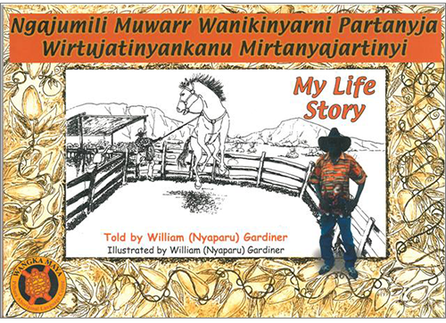
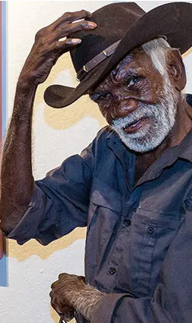
My Life Story - William (Nyaparu) Gardiner
How to pronounce
Nyangumarta words:
Emphasis on the first syllable
<a> is a /u/ sound (like cup)
<u> is an /oo/ sound (like choose)
Nyaparu = Nyu-pu-roo
Images courtesy of Wangka Maya P.A.L.C., Spinifex Hill Studio and Mr Gardiner’s family.
The 1946 Strike / Y6 / ENGLISH / Lesson 3 / 2

Slide 3
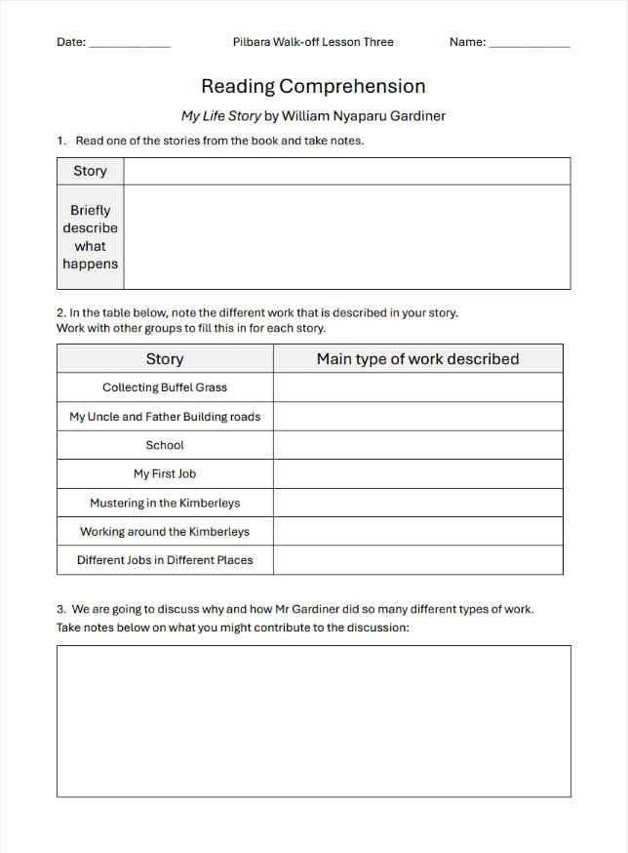
Reading Comprehension
  As a group, read your story and summarise what happens
  List the different work that
  happens in the story. Talk to other groups until you have filled this in for each story.
  Note down a thought our question you can contribute to our class discussion
The 1946 Strike / Y6 / ENGLISH / Lesson 3 / 3

Slide 4
Class Discussion
Why did Mr Gardiner do so many different types of work?
What does this tell us about his life?
Were his family with him?
Where do you think they all stayed when he worked?
What were his working conditions like?
How did he get paid?
The 1946 Strike / Y6 / ENGLISH / Lesson 3 / 4

