Slide 1

Lesson 2
Lesson Intention:
Contrast citizens’ rights with the rights and restrictions of Aboriginal people in Western Australia during the early 20th Century
Success Criteria:
I can compare different historical sources to find answers to my questions
I can use criteria (such as dates) to find and record relevant information
I can display the information I have gathered in a chart and use it to compare the rights of different Australians in the early 20th Century
The 1946 Strike / Y6 / HASS / Lesson 2 / 1

Slide 2
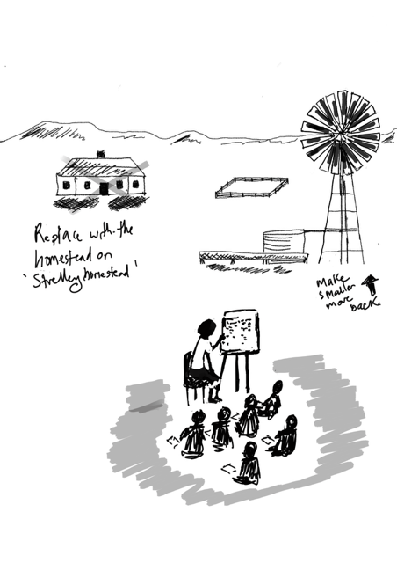
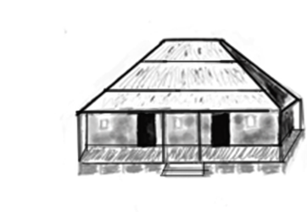
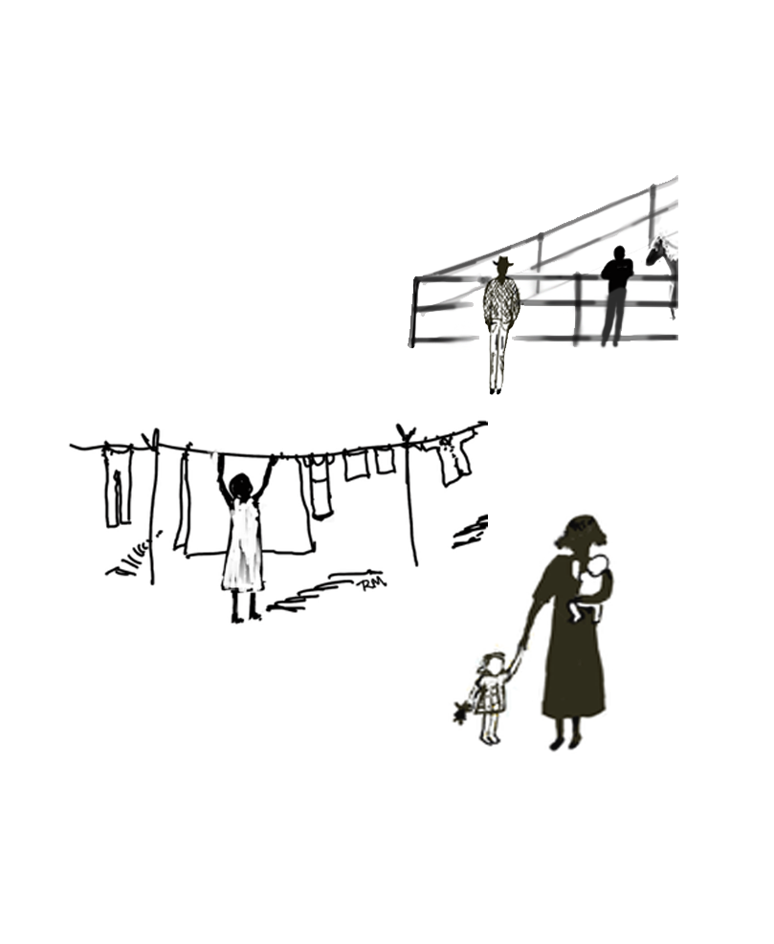
What was the citizenship status of Aboriginal people at this time?
Is there such thing as a non-citizen?
What might it have been like to be one?
The 1946 Strike / Y6 / HASS / Lesson 2 / 2
Notes:
What was the citizenship status of Aboriginal people at this time?
Is there such thing as a non-citizen?
What might it have been like to be one?

Slide 3
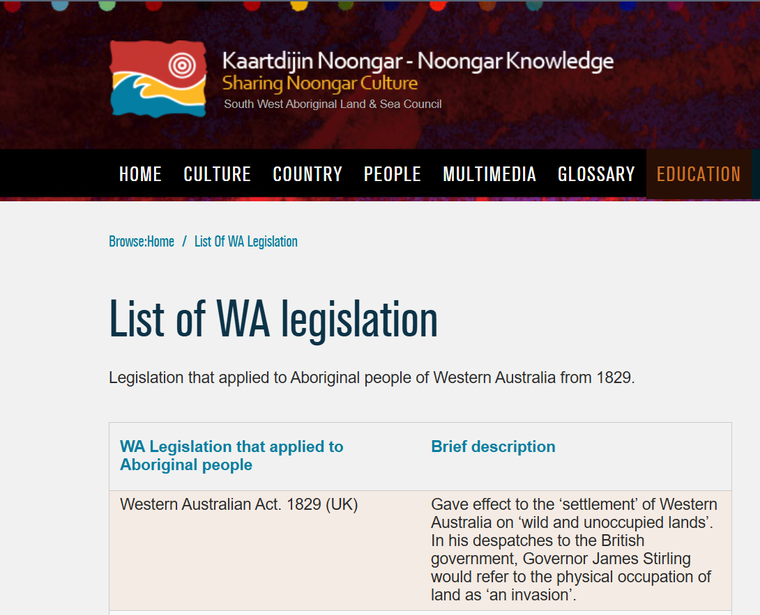

What were the laws that governed Aboriginal Australians from 1900-1945?
1. Follow the link to this website
2. Scan through the names of the legislation in the left column to find the dates you need: 1900-1945
Choose 3 pieces of legislation in this date range to share with the class.
Get ready to share:
  What is the name of this legislation?
  What does the description say?
  How would this affect Aboriginal Australians?
The 1946 Strike / Y6 / HASS / Lesson 2 / 3
Notes:
Remind students that legislation prior to 1900 would still govern Aboriginal Australians until it was amended.
Students infer from the information on Western Australian laws discussed what restrictions were placed on Aboriginal people in WA [Note: inference is required as the laws do not specify what rights are NOT to be enjoyed by Aboriginal people.]
No freedom to move around
Children had to work
Families could be kept apart
Government could prevent you from speaking your own language
Needed permission to marry
Unable to stay with family, speak their language etc, if they wanted citizen rights in the form of a ‘Native Pass’.

Slide 4
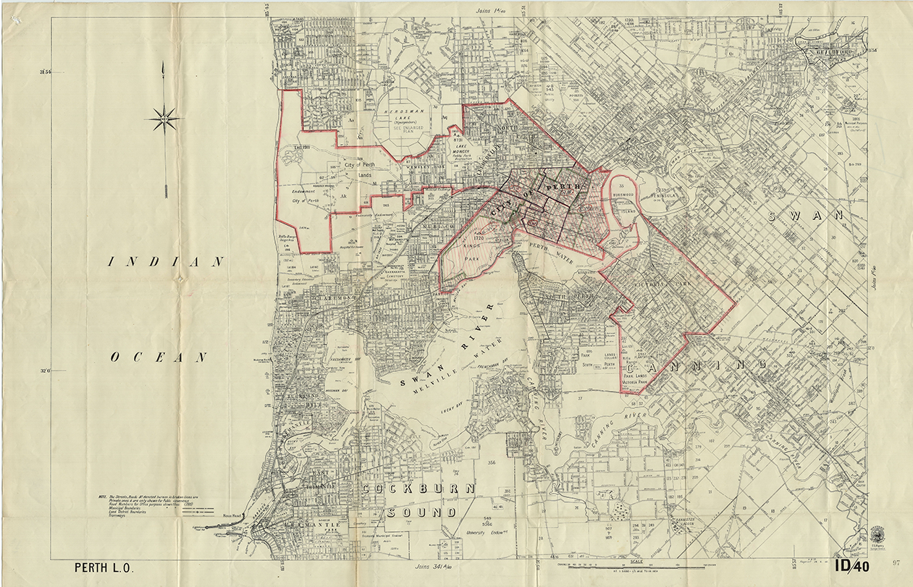
Perth Prohibited Area
What does “Freedom of Movement” mean?
What area is shown on
this map?
What do the red lines
indicate?
The 1946 Strike / Y6 / HASS / Lesson 2 / 4
Notes:
"Be aware some regional towns also had restrictions."

Slide 5
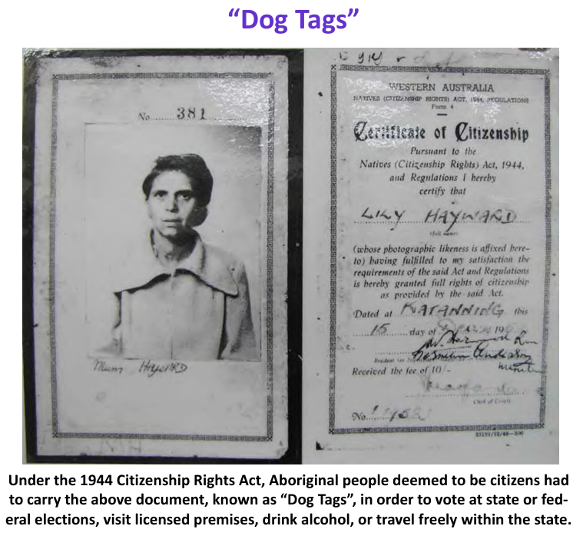
Native Citizenship Rights Act, 1944
Requirements:
Spoke English
Were healthy and had
no diseases
Lived in a similar way to
white people
Could manage money
Worked in a job, and
Had stopped seeing their
Aboriginal family and friends.
The 1946 Strike / Y6 / HASS / Lesson 2 / 5
Notes:
Discussion points:
- How would it feel if you were Aboriginal to choose between seeing your family and getting citizen rights?

Slide 6
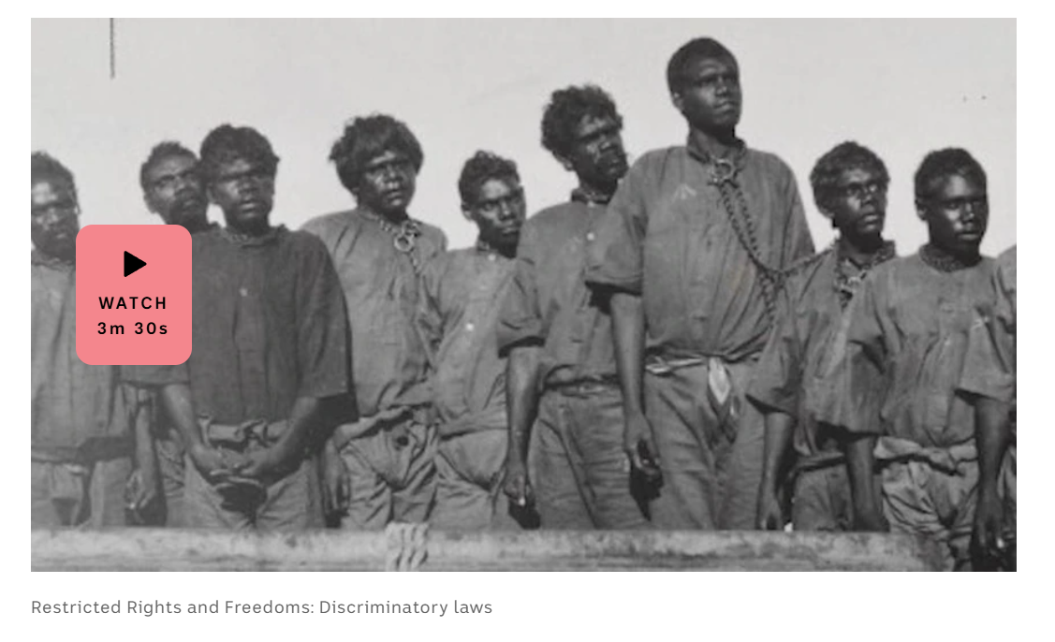
Watch “Restricted Rights and Freedoms: Discriminatory laws”
How would you feel as an Aboriginal Australian at this time?
The 1946 Strike / Y6 / HASS / Lesson 2 / 6
Notes:
Discussion points:
- How would it feel if you were Aboriginal to choose between seeing your family and getting citizen rights?

Slide 7
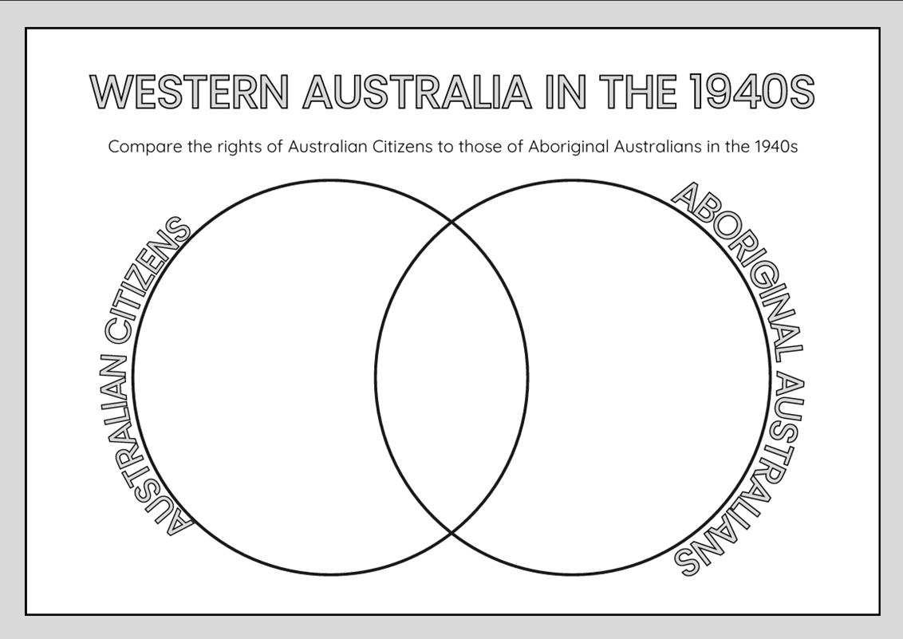
Compare and Contrast
Consider what we have learned about Australian society and laws in the early 20th Century:
  What rights were held by all Australians?
  What rights were only held by Australian citizens?
  What restrictions were placed
  on Aboriginal Australians?
The 1946 Strike / Y6 / HASS / Lesson 2 / 7

