Slide 1


Lesson 1
Lesson Intentions:
Describe the rights held by Australian Citizens in the first part of the 20th Century
Identify whether First Nations people had the same rights.
Success Criteria:
I can explain the key values of the Australian Constitution
I can evaluate whether the Constitution represented the rights of ALL Australians
I can develop questions to investigate the rights of First Nations Australians in the early years of the 20th Century
The 1946 Strike / Y6 / HASS / Lesson 1 / 1

Slide 2
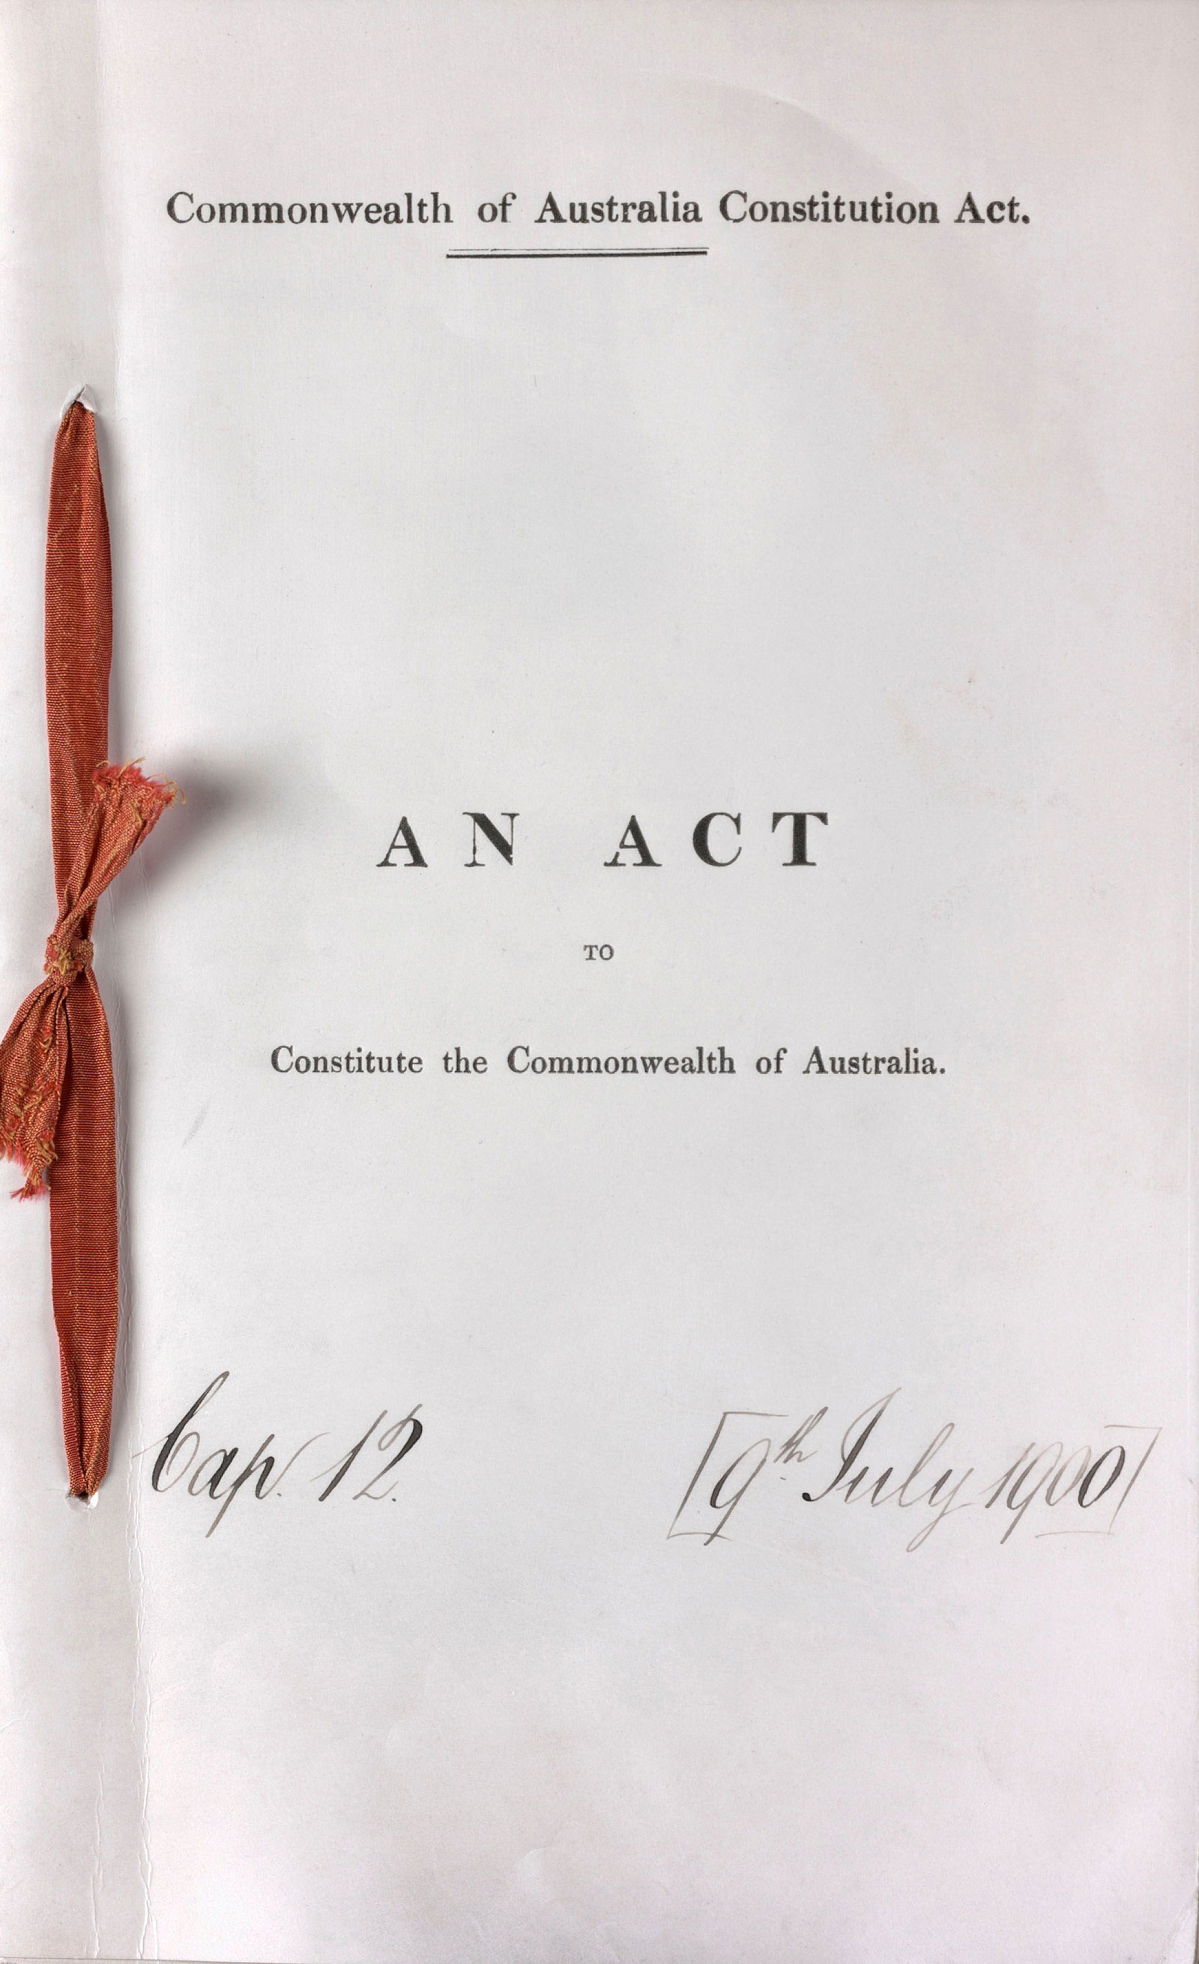
What do we already know about the rights of Australians in the 20th Century?
What was Federation?
When did it occur?
What was the Law which brought all the States together as a Federation?
Were all Australians recognised as citizens equally under the Constitution?
Where do we go to find out about what rights we have as citizens of Australia?
Did all Australians get recognised as having the same rights under the Constitution?
The 1946 Strike / Y6 / HASS / Lesson 1 / 2
Notes:
What was Federation? (When all the States came together as a Nation.)
When did it occur? (In 1901)
What was the Law which brought all the States together as a Federation? (The Australian Constitution.)
Were all Australians recognised as citizens equally under the Constitution? (Yes/No.)
Where do we go to find out about what rights we have as citizens of Australia? (The Constitution).
Did all Australians get recognised as having the same rights under the Constitution? (We need to find out – some students may already know)

Slide 3
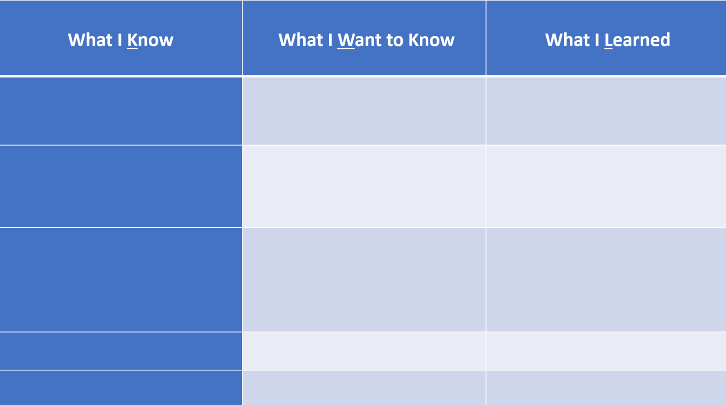
The 1946 Strike / Y6 / HASS / Lesson 1 / 3

Slide 4
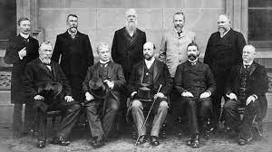
What can you see about the people involved in making the Constitution?
What might be different about it if other people were involved
(e.g women and Aboriginal and Torres Strait Islander people)?
The 1946 Strike / Y6 / HASS / Lesson 1 / 4

Slide 5

http://www.australianconstitutioncentre.org.au/
What are the six Big Ideas that are baked into our
Australian Constitution?
The 1946 Strike / Y6 / HASS / Lesson 1 / 5
Notes:
Show whole video and note ‘big ideas’ at following points:
Democracy (at 2:24 mins) - ‘no matter how powerful or ordinary you are’
The Rule of Law (at 2:40 mins) - ‘a set of rules that everyone has to follow’, where ‘everyone is equal under the rule of law, even the King’
A Separation of Powers (at 3:08 mins) Federalism (at 3:20 mins)
Rights (at 3:50 mins)
Nationhood (at 4:15 mins)
At 4:20 mins [show on slide as they are identified by students].
State that the learning focus is on the Rights held by citizens which the constitution protects.
‘the people that wrote the Constitution thought that taking away someone’s land without paying for it was a terrible thing to do’
the right to believe in your own religion (at 4:00 mins).
Direct students to look for information about Aboriginal rights (these rights are not articulated, and students need to surmise for themselves why this information is missing)
What questions does the video raise? What did the video say about Aboriginal people? (That they ‘were excluded at the time’, at 5:30 mins).

Slide 6
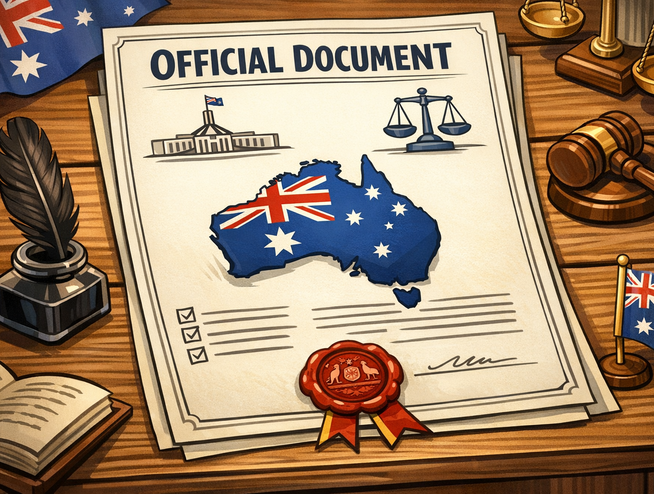
Australian Constitution
Democracy – everyone has an equal say
(by vote)
Rule of Law - everyone gets equal treatment under the law
Separation of Powers –
between Parliament
& Courts
Federalism – all States are one country (Federation)
Nationhood – a capital, a flag, an anthem…
Rights – the rights of citizens to be protected
The 1946 Strike / Y6 / HASS / Lesson 1 / 6
Notes:
What Rights are mentioned in the video?
(can rewatch to listen for these)
Rights:
Nobody could take your land from you
Free to follow your own religion

Slide 7
The 1946 Strike / Y6 / HASS / Lesson 1 / 7

Slide 8
Constitution (section 127)
'In reckoning the numbers of the people of the Commonwealth,
or of a State or other part of the Commonwealth,
aboriginal natives shall not be counted.’
The 1946 Strike / Y6 / HASS / Lesson 1 / 8
Notes:
Add further points to KWL Chart
Questions to investigate next lesson:
Aboriginal people are not counted in the Constitution, does this mean they are citizens?
What rights might they have?
Where are those rights defined?

